Slide 1
CIPD webinar series
Is successful hybrid working feasible for you?
11 May 2022

Slide 2
Welcome
Katie Jacobs
Senior Stakeholder Lead – CIPD

Slide 3
Today’s speakers
Katie Jacobs
Senior Stakeholder Lead, CIPD
Claire McCartney
Senior Policy Advisor – Resourcing and Inclusion, CIPD
Gary Cookson
Director at Epic HR and Author
Lisa Faulkner
Head of People,
FSCS

Slide 4
#StrongerWithCIPD
Covid-19 resources
NEW Well-being helpline
Employment Law helpline
Communities and branches
People Management
Knowledge and content
Free learning
Careers support
Professional creditability
Financial support
cipd.co.uk/memberbenefits

Slide 5
*New* Wellbeing Resources
We’ve partnered with Health Assured to support members mental health and wellbeing
Unlimited free 24/7 confidential telephone helpline, online portal & Health e-Hub app
The resource provides:
Legal information
Debt and financial information
Manager consultancy and support
Information on work and home issues
Factsheets, advice, information and self-help tools
Links to specialist support organisations
A resources area with; programmes, videos, webinars, medical information and mini health checks.

Slide 6
An update on hybrid and wider flexible working
Claire McCartney, CIPD Senior Policy Adviser

Slide 7
A growing focus on hybrid working
Two-fifths of employers plan to invest in more home & hybrid working in next 6 - 12 months

Slide 8
Benefits & challenges of hybrid working
Benefits
Challenges
Improved work-life balance
Better employee satisfaction
Greater business flexibility
Stress or mental health issues
Lack of space or privacy
Employee conflict

Slide 9
Real improvements in productivity
Increased productivity | Decreased productivity
2021/22 41% 18%
2020/21 33% 23%

Slide 10
Lack of consultation
Three-fifths (63%) of employees haven’t been asked how they would like to work moving forward
Mismatch between employee and employer working preferences

Slide 11
Concerns about inclusion risks
Almost half (48%) of employers are concerned about hybrid/ home working inclusion risks
Almost a quarter (24%) of employees who work from home / hybrid are concerned about being treated less favourably than colleagues always in the workplace

Slide 12
Greater focus on other types of flexible working needed
Less than a quarter taking steps to increase other forms of flexible working in the next 6 - 12 months

Slide 13
What flexible hours arrangements do people currently use and what would they choose? (%)
Use Choose
Annualised hours 4 13
Flexi-time 21 42
Term-time working 1 8
Job share 1 5
Compressed hours 4 32
Part-time hours 19 21

Slide 14
Lack of flexibility prompting job /career changes
4% of employees say they have left a job in the last year specifically due to a lack of flexible working
9% have changed their careers/profession due to a lack of flexible working options within the sector.

Slide 15
Flexible and hybrid working suggestions
Develop policies that allow employees to request flexible working from day one of employment.
Raise awareness of different forms of flexible working and explore how they can be effective in roles that have traditionally been seen as non-flexible.
Consult and collaborate with employees when designing hybrid working practices.
Assess organisation risks relating to equality and inclusion and develop an action plan to ensure that hybrid working supports inclusion.
Provide training to managers on how to manage hybrid teams effectively.

Slide 16
CIPD Resources
An update on flexible and hybrid working practices
Hybrid working case studies
Effective hybrid Working in partnership with the Flexible Working Taskforce
Line manager guide in supporting hybrid working
Employer and Employee guides to requesting flexible working
Cross-sector insights in enabling flexible working

Slide 17
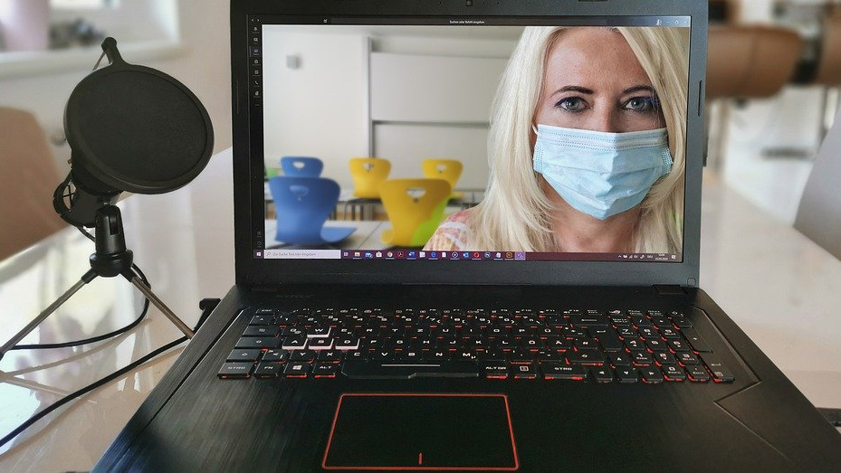
The new normal?
@Gary_Cookson

Slide 18
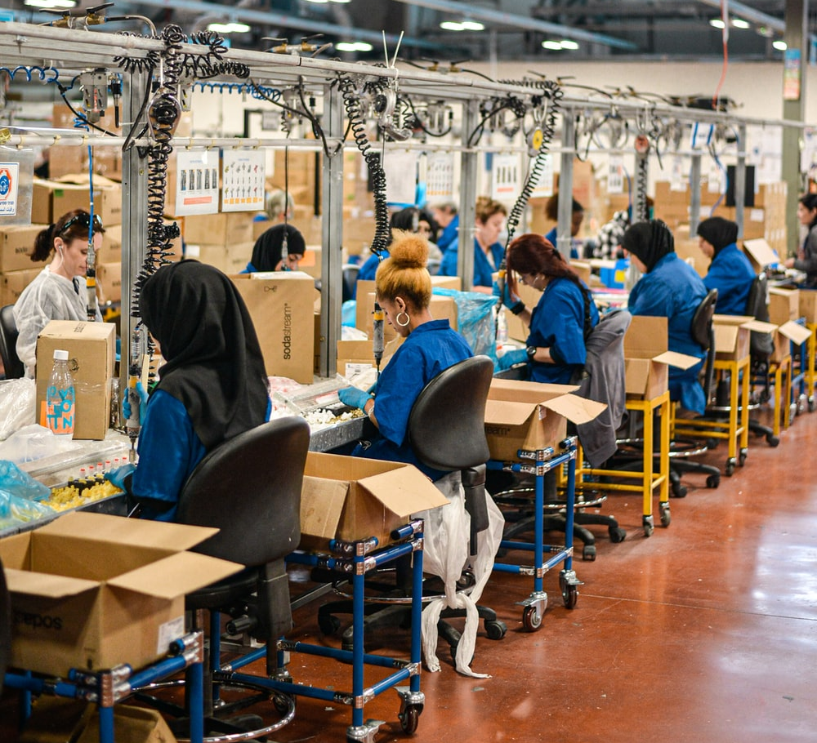
What’s the reality at your organisation?

Slide 19
What is it and where is it going?

Slide 20
What do we need to do?
Avoid duplicating the physical workplace remotely
Give proper attention to the set-up of remote workspaces
Invest in communication skills
Create and nurture internal communities
Provide more choice to employees over how they work.
Focus on inclusivity

Slide 21
A new leadership ask

Slide 22
Helping hybrid teams
Forming
Storming
Norming
Performing

Slide 23
Spaces and Places – not like this

Slide 24
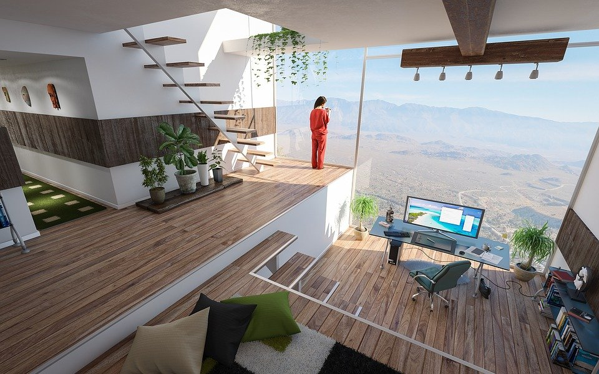
More like this…?

Slide 25
Form follows function…?
 | What type of work is taking place?
Where the work is taking place? | Synchronous work, in the physical workplace | Asynchronous work, in the physical workplace
 | Synchronous work, remote and online | Asynchronous work, remote and online

Slide 26
Questions
Please submit your questions for:
Claire McCartney, Senior Policy Advisor – Resourcing and Inclusion, CIPD
Gary Cookson, Director at Epic HR and Author
Lisa Faulkner Head of People, FSCS
Please use the Q&A function to submit your questions

Slide 27
*New* Wellbeing Resources
We’ve partnered with Health Assured to support members mental health and wellbeing
Unlimited free 24/7 confidential telephone helpline, online portal & Health e-Hub app
The resource provides:
Legal information
Debt and financial information
Manager consultancy and support
Information on work and home issues
Factsheets, advice, information and self-help tools
Links to specialist support organisations
A resources area with; programmes, videos, webinars, medical information and mini health checks.

Slide 28
#StrongerWithCIPD
Covid-19 resources
NEW Well-being helpline
Employment Law helpline
Communities and branches
People Management
Knowledge and content
Free learning
Careers support
Professional creditability
Financial support
cipd.co.uk/memberbenefits

