Slide 1
CIPD webinar: Independent HR consultants – how to adapt for turbulent times
09 March 2023, 12:00 – 13:00

Slide 2
Welcome
Katie Jacobs
Senior Stakeholder Lead, CIPD

Slide 3
Today’s speakers
Ian Pettigrew
Kingfisher Coaching
Kathleen McAdams
Director,
Albany HR

Slide 4
#StrongerWithCIPD
Covid-19 resources
NEW Well-being helpline
Employment Law helpline
Communities and branches
People Management
Knowledge and content
Free learning
Careers support
Professional creditability
Financial support
cipd.co.uk/memberbenefits

Slide 5
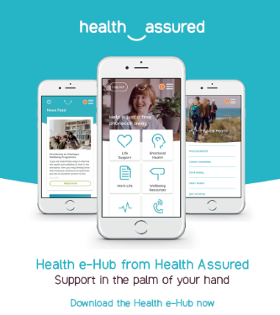
Wellbeing Resources
We’ve partnered with Health Assured to support members mental health and wellbeing
Unlimited free 24/7 confidential telephone helpline, online portal & Health e-Hub app
The resource provides:
Legal information
Debt and financial information
Manager consultancy and support
Information on work and home issues
Factsheets, advice, information and self-help tools
Links to specialist support organisations
A resources area with; programmes, videos, webinars, medical information and mini health checks.
Notes:
In recognition of the increased pressure and personal challenges many of you might currently be facing we’re launched a new Well-being helpline for the UK and Ireland. Calls are FREE and confidential. Phonelines are open 24 hours a day, 7 days a week, 365 days a year.
Work through your problems with a qualified therapist accredited by the British Association for Counselling and Psychotherapy (BACP).
Legal information services - support on a range of issues including personal, financial and legal matters.
Debt and financial information - support for issues such as debt, investments, pensions, managing money, negotiating with creditors.
Manager consultancy and support - at helping people managers to support their teams effectively.
Plus there are online resources and a well-being app you can download.

Slide 6
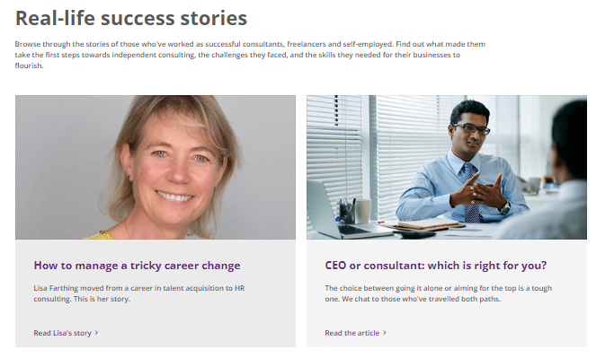
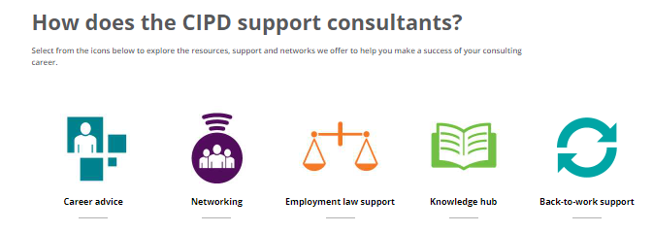
cipd.co.uk/careers/work-environments/self-employment

Slide 7
Questions
Please submit your questions for:
Ian Pettigrew, Kingfisher Coaching
Kathleen McAdams, Director at AlbanyHR
Please use the Q&A function to submit your questions

Slide 8
Wellbeing Resources
We’ve partnered with Health Assured to support members mental health and wellbeing
Unlimited free 24/7 confidential telephone helpline, online portal & Health e-Hub app
The resource provides:
Legal information
Debt and financial information
Manager consultancy and support
Information on work and home issues
Factsheets, advice, information and self-help tools
Links to specialist support organisations
A resources area with; programmes, videos, webinars, medical information and mini health checks.
Notes:
In recognition of the increased pressure and personal challenges many of you might currently be facing we’re launched a new Well-being helpline for the UK and Ireland. Calls are FREE and confidential. Phonelines are open 24 hours a day, 7 days a week, 365 days a year.
Work through your problems with a qualified therapist accredited by the British Association for Counselling and Psychotherapy (BACP).
Legal information services - support on a range of issues including personal, financial and legal matters.
Debt and financial information - support for issues such as debt, investments, pensions, managing money, negotiating with creditors.
Manager consultancy and support - at helping people managers to support their teams effectively.
Plus there are online resources and a well-being app you can download.

Slide 9
#StrongerWithCIPD
Covid-19 resources
NEW Well-being helpline
Employment Law helpline
Communities and branches
People Management
Knowledge and content
Free learning
Careers support
Professional creditability
Financial support
cipd.co.uk/memberbenefits

